Slide 1
Coding goals:
Use your knowledge of “comments” and fraction visuals to create videos that show solutions to fraction division problems.

Slide 2
Coding and Math goals:
This is part of your final art integrated assessment for fraction division!
Be diverse and focused!
Notes:
Apply and extend previous understandings of multiplication and division to divide fractions by fractions.
CCSS.Math.Content.6.NS.A.1
Interpret and compute quotients of fractions, and solve word problems involving division of fractions by fractions, e.g., by using visual fraction models and equations to represent the problem.

Slide 3
Coding goals:
Let’s get to know the coding first!

Slide 4

Making and Downloading Videos with Fraction Objects
Change the fractions and comments.
Change the speed.

Slide 5
Creating a video for multiplication
Change the multiplication problem.
Change the comments.
Change the speed.

Slide 6
Video part 2
Adding text to your video.
Adding picture to your video.
Putting it all together.

Slide 7
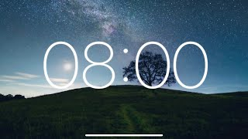
Warm ups
Pass the student handout with division problems.
Work independently on your warms ups.
Think about how you can use the coding you just learned to show your solutions!

Slide 8
Use the coding!
Check with your team that you agree on the correct diagrams and solutions.
Check your answers on the computer using coding.
Create videos to show your answers. Download them if finished!

Slide 9
Shout outs!

Slide 10
Main lesson
Work independently on your assigned problem
Work on a different problem if you have extra time.
Think about how you can use the coding you just learned to show your solutions!

Slide 11

Use the coding!
Check with your team that you agree on the correct diagram and solution.
Check your answers on the computer using coding.
Create videos to show your answers.
Download them if finished!
Diversity, Details, Organization
Add pictures or comments to explain

Slide 12
Shout outs!

Slide 13
Creativity Practice
We want to create a story about our fraction
video!
We will practice being creative by adding images
that correspond to the video story.
Optional: Use next slides to practice the story.

Slide 14
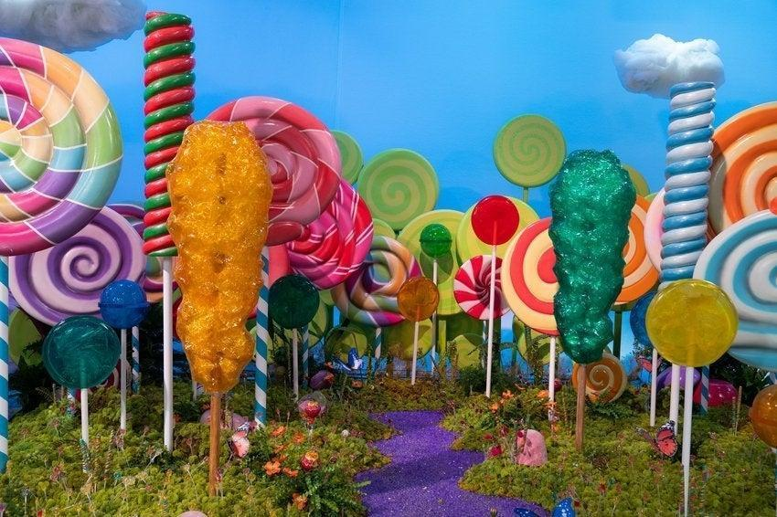
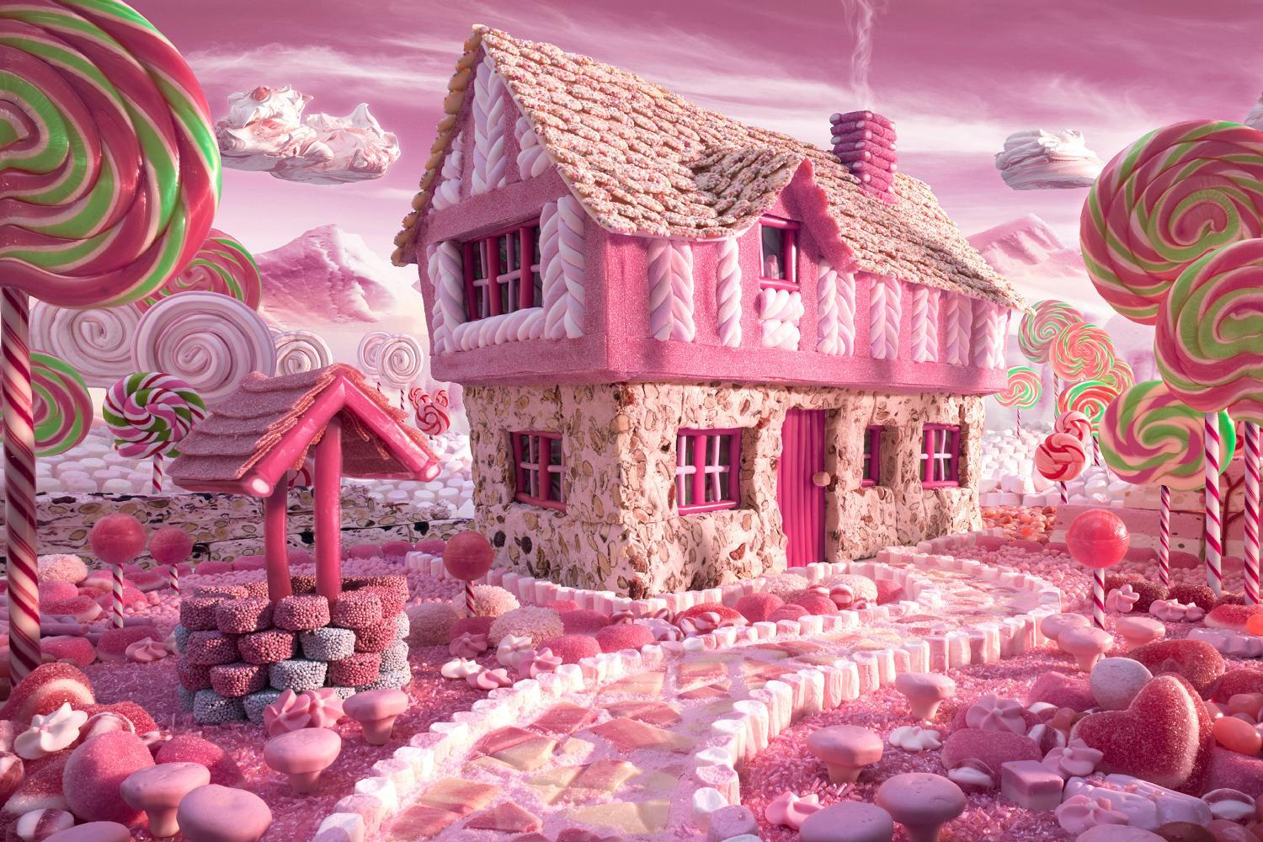
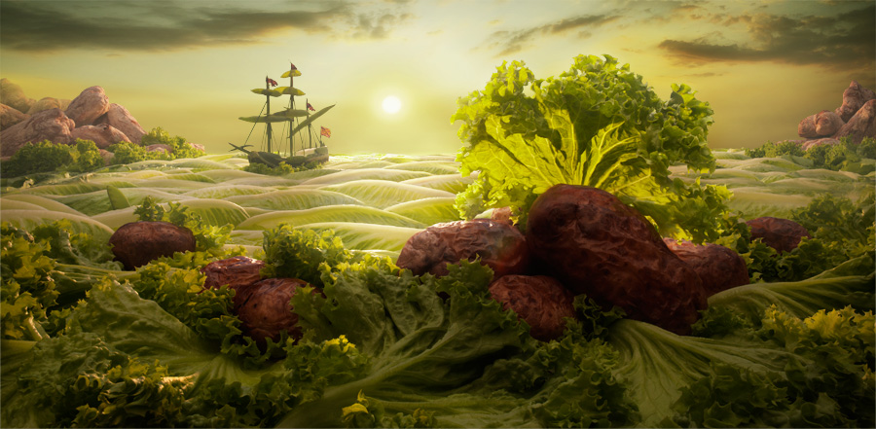
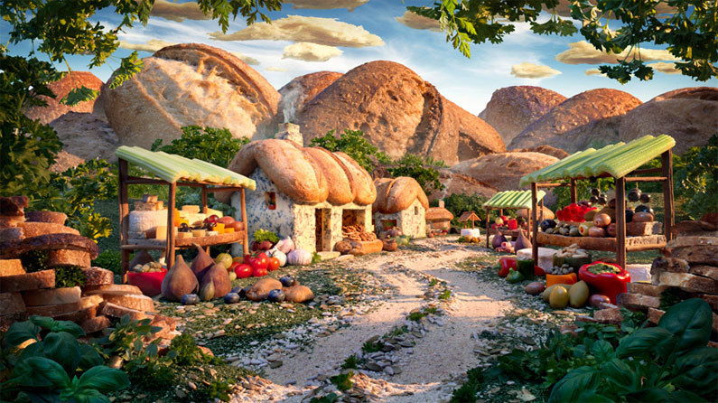
Create a visual or a story
The images are examples of a land made of:
Pudding (chocolate or vanilla)
Cookies (oreos or vanilla wafers)
Whipped cream and a gummy worms

Slide 15
Art Block

Slide 16
Art Block

Slide 17
Art Block

Slide 18
Art Block

